Slide 1

Sprocket Central Pty Ltd
Data analytics approach by
Gorge Johnson - [Engagement Manager], [Senior Consultant], [Junior Consultant]

Slide 2

Agenda
Introduction
Data Exploration
Model Development
Interpretation

Slide 3
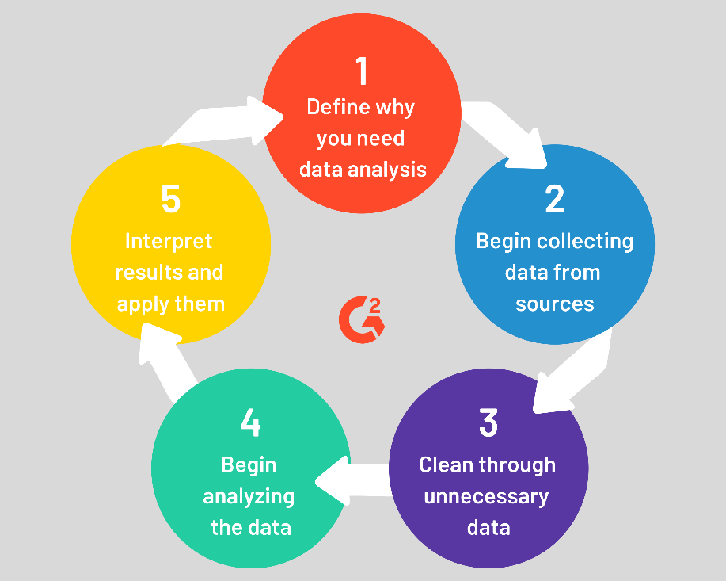
Introduction
What is Data Analytics ?
Data Analytics is the process of collecting, cleaning, sorting, and processing raw data to extract relevant and valuable information to help businesses. An in-depth understanding of data can improve customer experience, retention, targeting, reducing operational costs, and problem-solving methods.

Slide 4
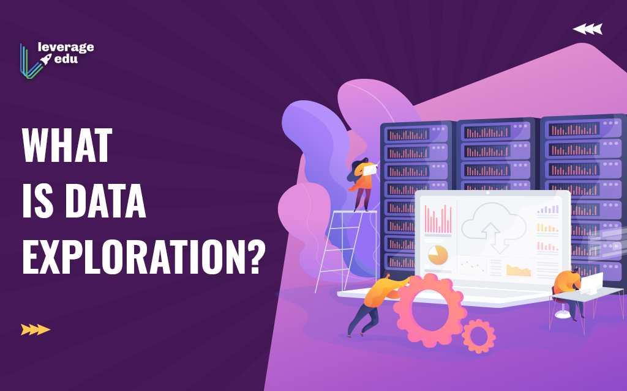
Data Exploration
What is Data Exploration?
Data exploration is an approach similar to initial data analysis, whereby a data analyst uses visual exploration to understand what is in a dataset and the characteristics of the data, rather than through traditional data management systems
Two key advantages of data exploration are…
To enable unexpected discoveries in the data
To foster a deep understanding of the data as
an important fundament for successful and efficient data science projects.

Slide 5
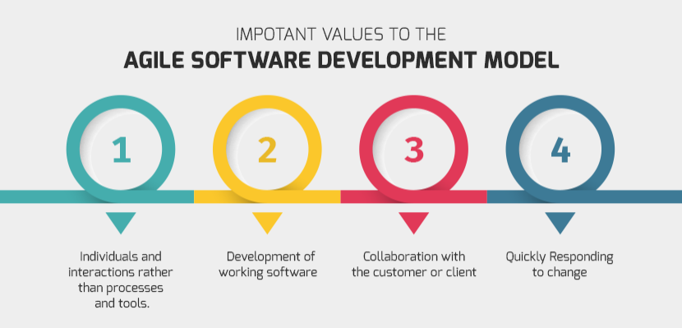
Model Development
What is the Use of Model Development?
Model development is an iterative process, in which many models are derived, tested and built upon until a model fitting the desired criteria is built. Subsequent modelling work may need to begin the search at the same place as the original model building began, rather than where it finished.
Types of Software Development Models:
Waterfall Model.
V-Model.
Incremental Model.
RAD Model.
Agile Model.
Iterative Model.
Spiral Model.
Prototype Model.

Slide 6
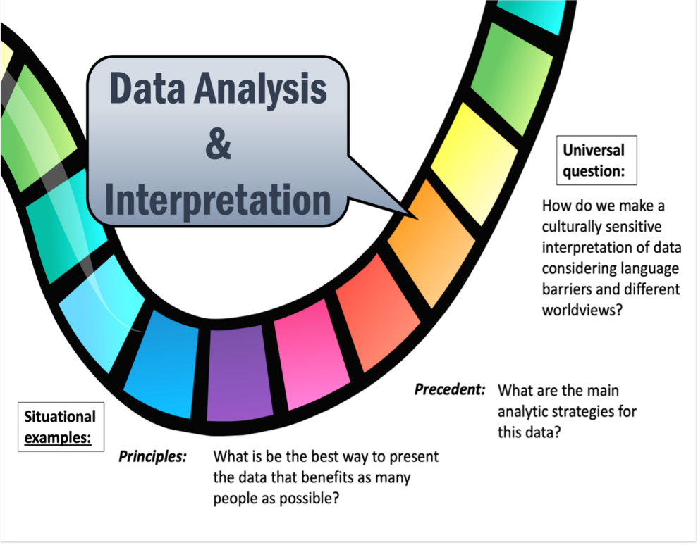
Interpretation
What is mean by interpretation?
Data interpretation is the process of reviewing data and arriving at relevant conclusions using various analytical research methods. Data analysis assists researchers in categorizing, manipulating, and summarizing data to answer critical questions.
What are the 4 steps of data interpretation?
Assemble the information you'll need.
Develop findings
Develop conclusions
Develop recommendations.

Slide 7
Thank You
For Your Time

